Slide 1
Atliq Hardwares Insights for Ad-hoc requests (Financial measures)

Slide 2
About Atliq Hardware
Atliq Hardware (imaginary company) is one of the leading computer hardware producers in India and well expanded in other countries too.
Company has spanned its business remarkably worldwide in 27 countries which are in Asia, Pacific Europe, North America and Latin America regions.

Slide 3
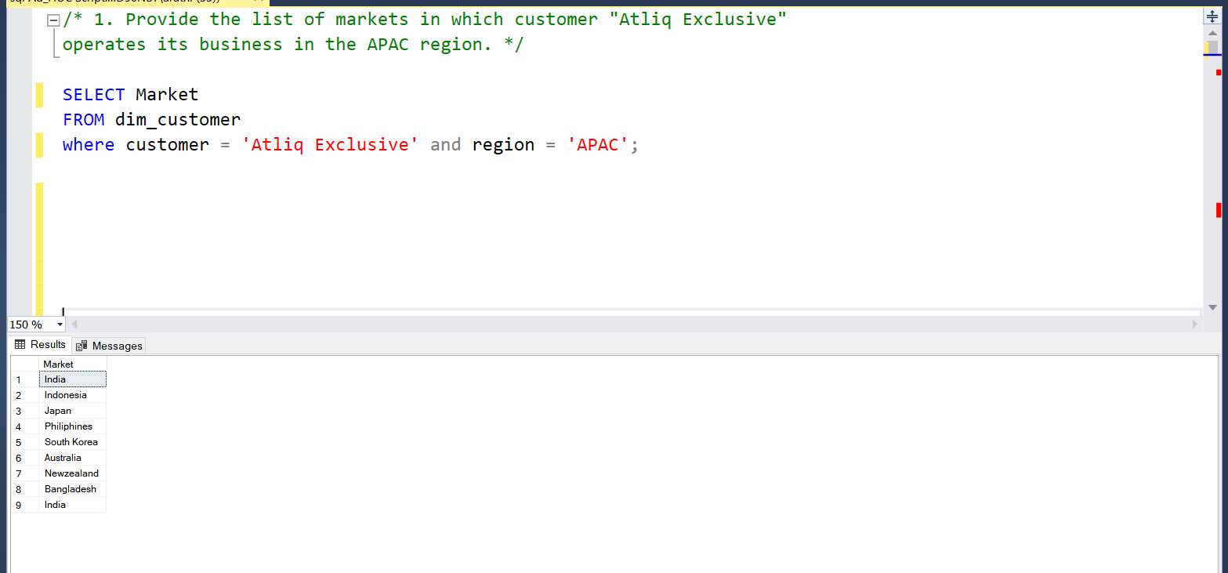
Request 1

Slide 4
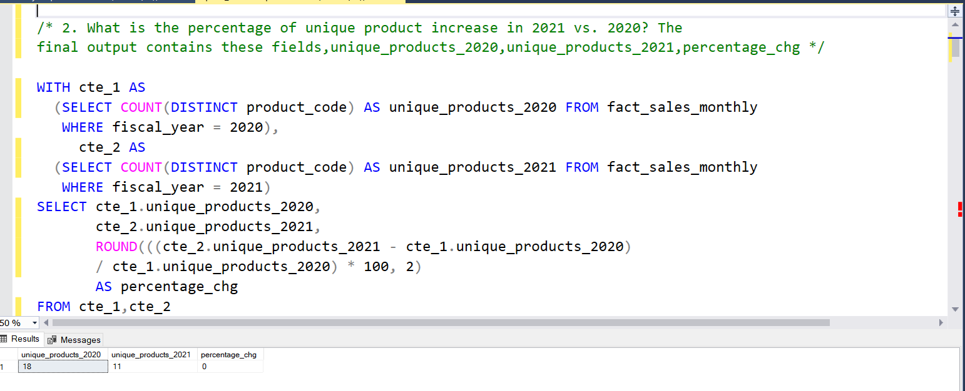
Request 2

Slide 5
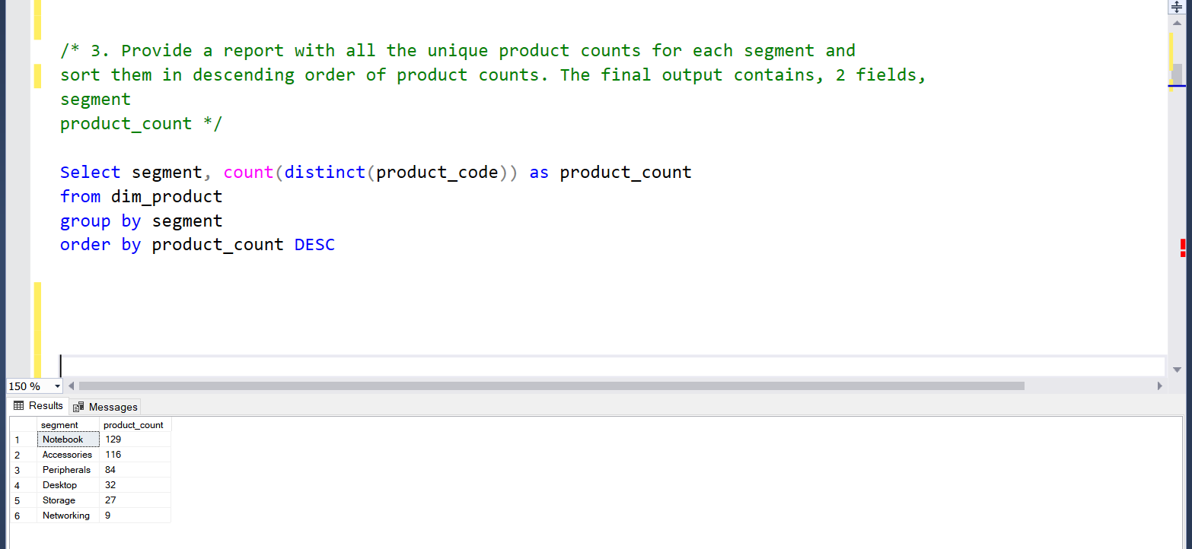
Request 3

Slide 6
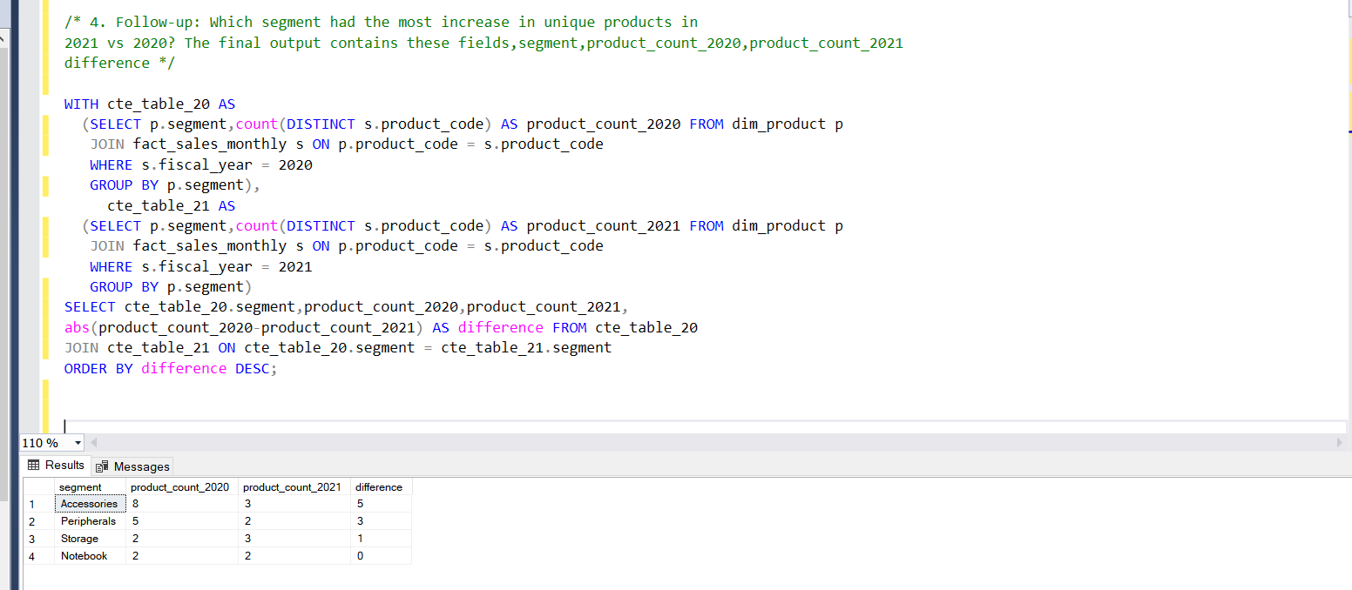
Request 4

Slide 7
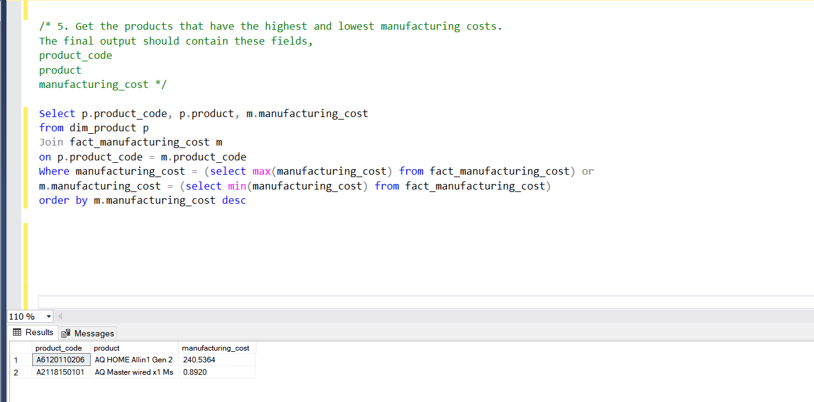
Request 5

Slide 8
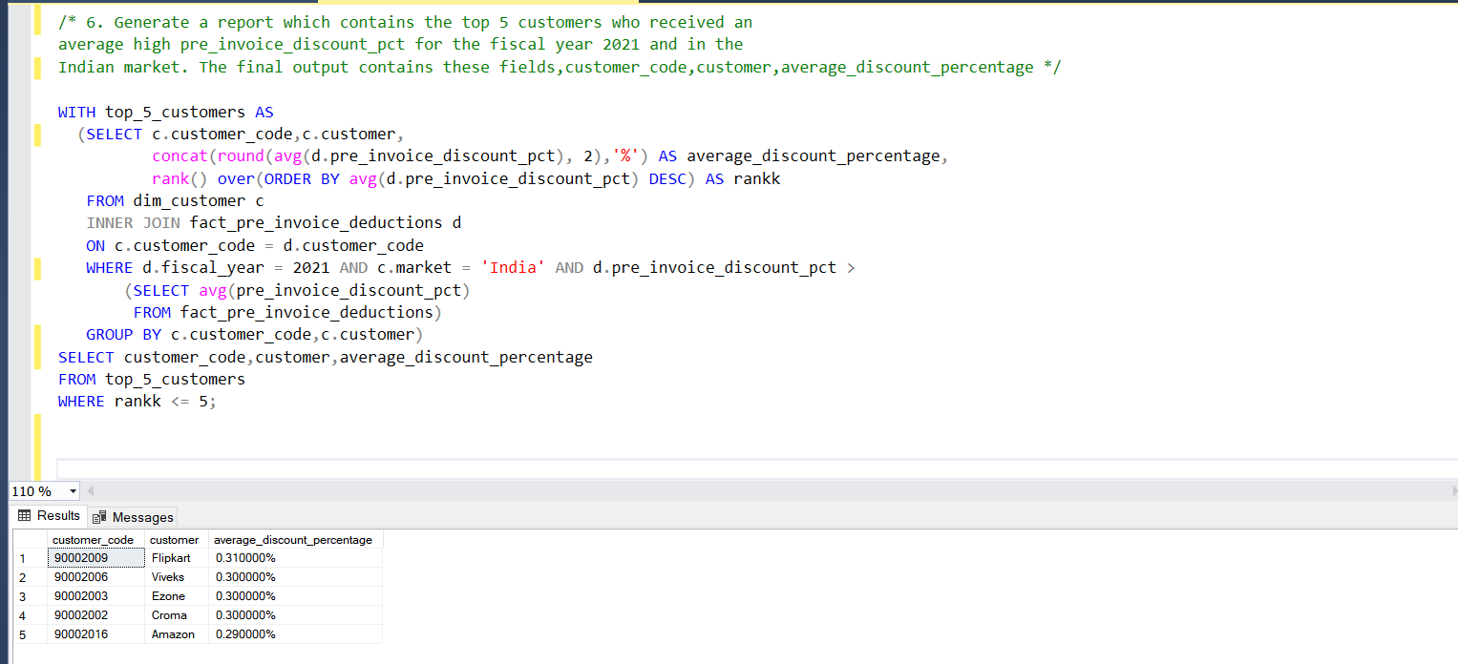
Request 6

Slide 9
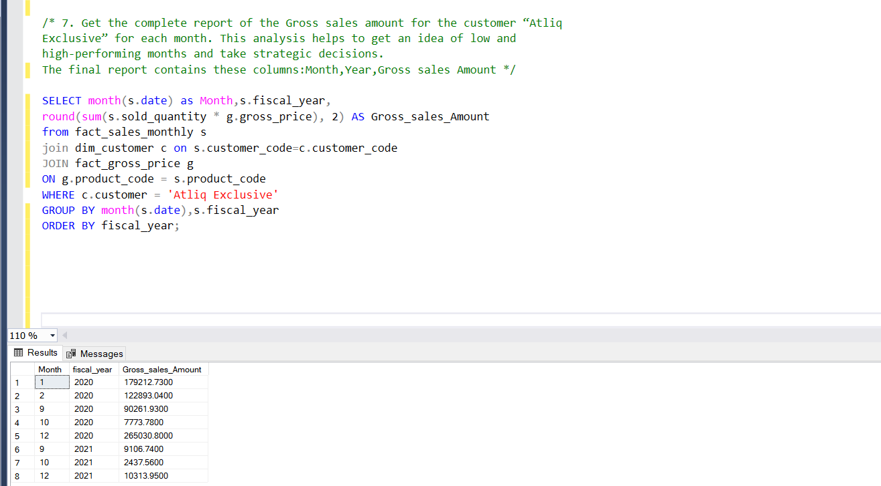
Request 7

Slide 10

Request 9

Slide 11
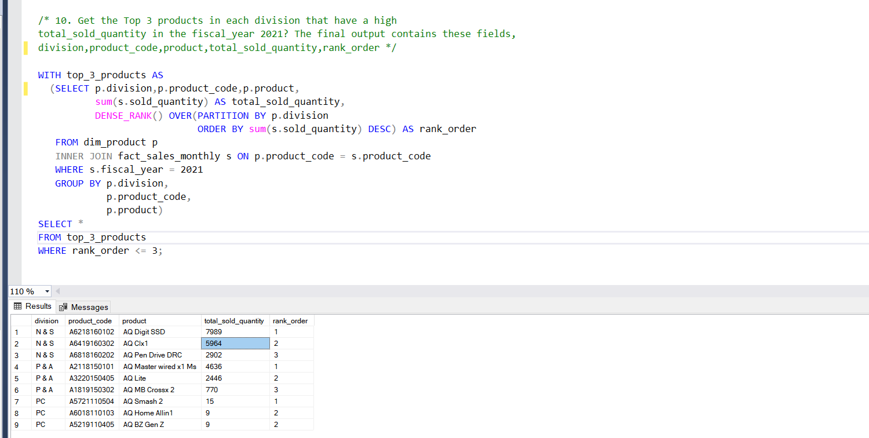
Request 10

